Slide 1
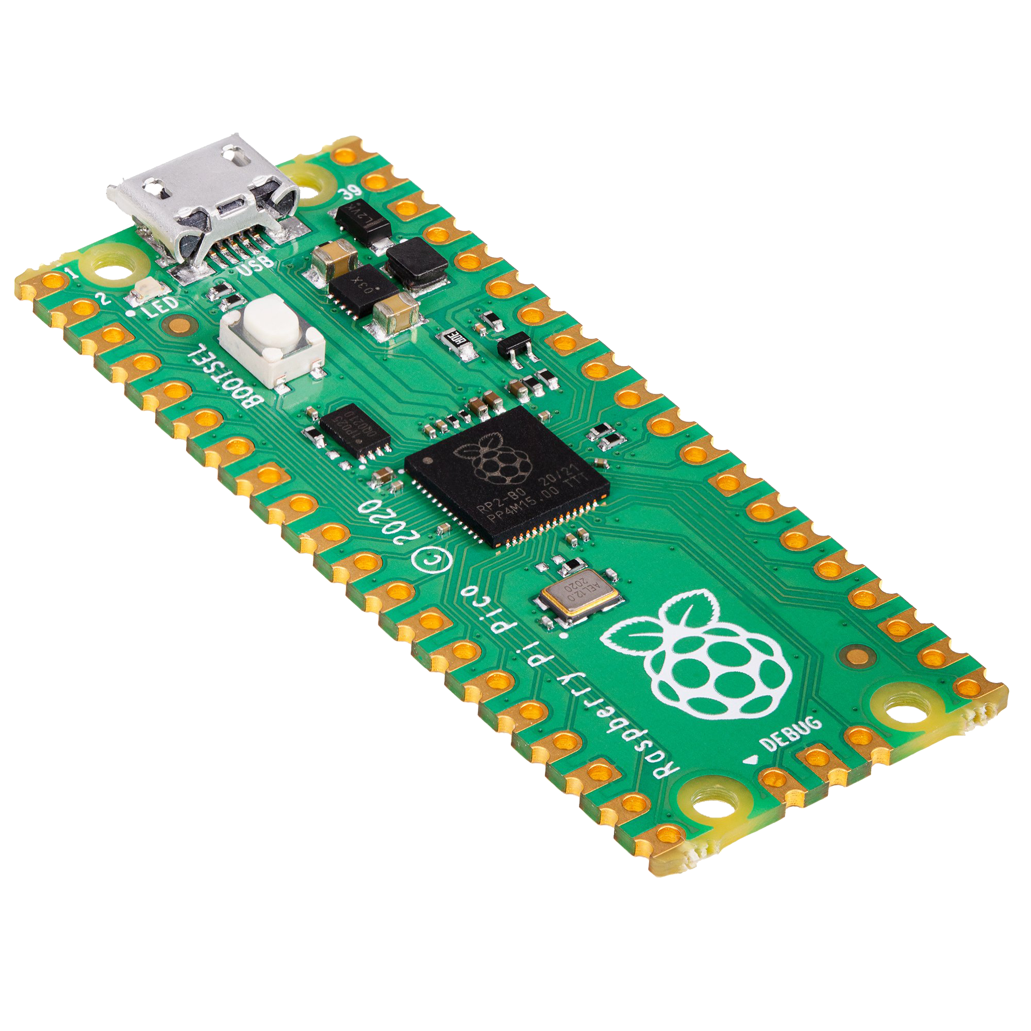
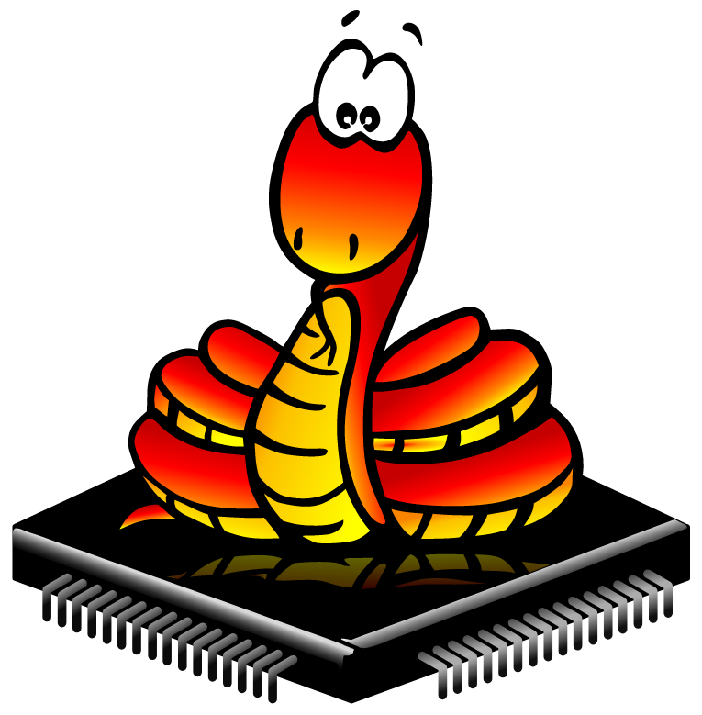
Intro to MicroPython Workshop
Using the RPi Pico to interface with circuits

Slide 2
Raspberry Pi Pico
The Raspberry Pi Pico is a microcontroller development board
NOT the same as other Raspberry Pi boards!!
Pico is designed for physical computing projects, like controlling LEDs or buttons or even other microcontrollers
Pico does not come with pin headers attached (these have already been soldered on for you though)
The bottom of the Pico has labels for each of the pins
These pins WILL NOT be visible when the Pico is in a breadboard!

Slide 3
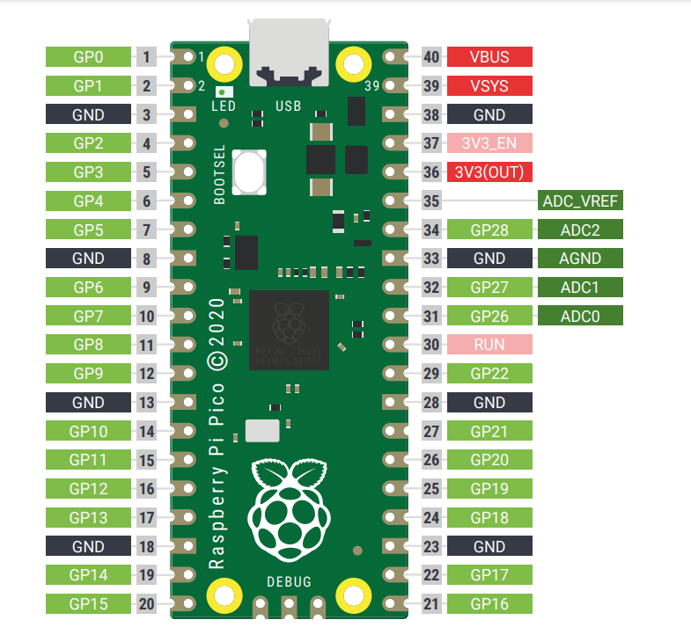
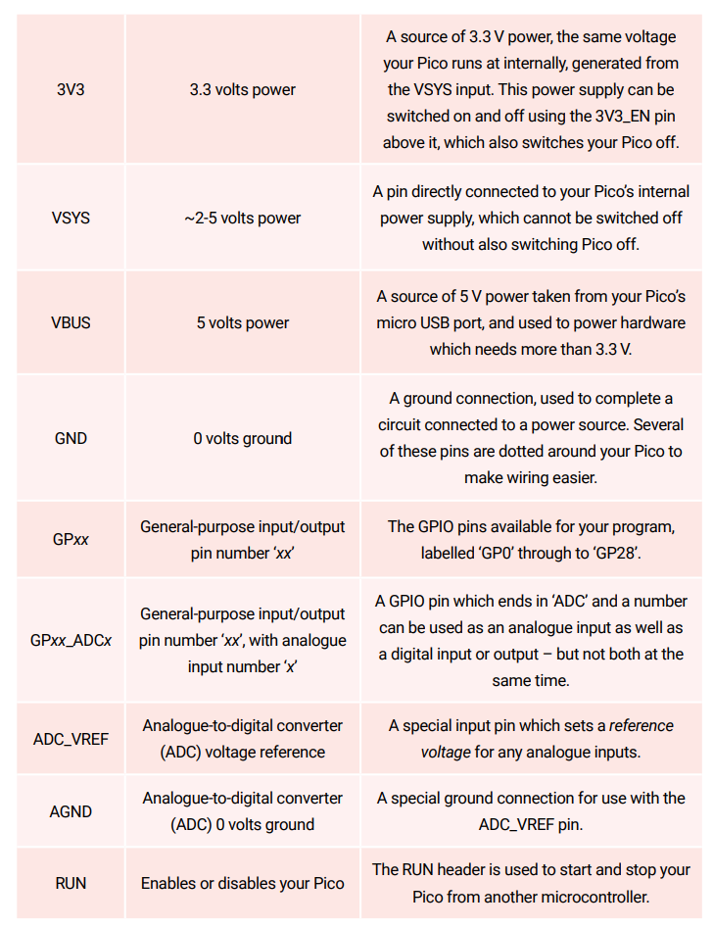

Slide 4
Getting MicroPython on the Pico
MicroPython is not installed on the boards by default, so we’ll be doing the following:
While holding the BOOTSEL button, plug the USB cable into the Pico and connect it to your computer
After 3 seconds, let it go
Your Pico should appear on your computer as a removable drive
Open the drive and look for the file “INDEX.HTM”
Double click this file and then click on the MicroPython tab and click on the “Download UF2 File” button to download MicroPython to your Pico
Navigate to your downloads folder to find the file we just downloaded - should be called “micropython(date/time).uf2”

Slide 5
Setting up Thonny IDE
Thonny IDE is an ‘Integrated development environment’ used for Python and MicroPython
To get set up, go to thonny.org and download Thonny
After connecting your Pico to your computer, launch Thonny
Click on Python Version box in the bottom right of the Thonny window (see next slide)
Select MicroPython (Raspberry Pi Pico) and click on it
If it doesn’t show up, make sure your Pico is connected to your computer properly
The bottom of Thonny should now say “MicroPython” and you are ready to code!

Slide 6
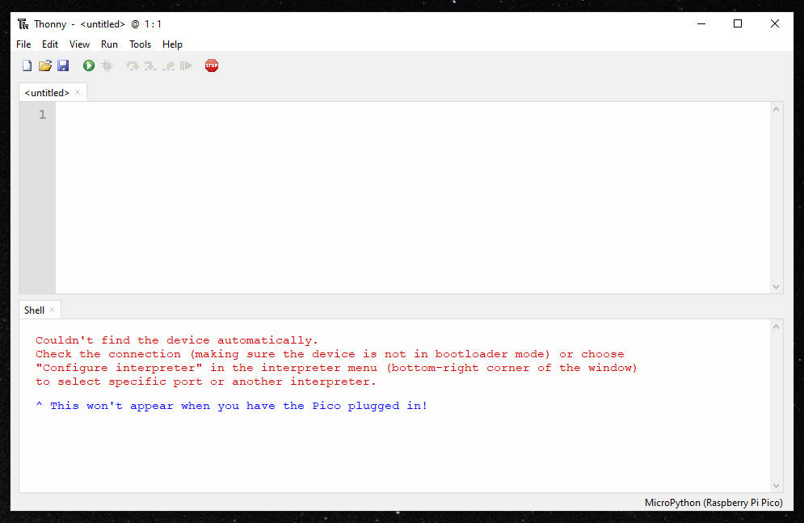
This is where you change ‘Python’ to ‘MicroPython’

Slide 7

Coding in MicroPython
Coding with Thonny in MicroPython follows the same basic syntax rules as Python
Code normally runs top to bottom, line by line
Indentation is used to control the sequence in which code is read (exactly like Python)
After writing your code, when you press to run the program, the code is uploaded and saved to your MicroPython, allowing you to take code on-to-move and use it away from your computer
Note: Files can save to the PC or to the Pico itself
main.py is special! This is the default program the Pico will run on boot.
Thonny allows users to run code through the shell (which sends information straight to the Pico every time you press enter) or using the script area (this is where we want to be doing our coding)

Slide 8
Hello, World!
In the script area in Thonny, type:
print(“Hello, World!”)
To run your first code, click the Run icon at the top of the Thonny window
It will ask you to save the file, add a descriptive title and click OK
INCLUDE ‘.py’ AT THE END OF YOUR FILE
Two lines should appear in the shell at the bottom of the Thonny window:
%Run -c $EDITOR_CONTENT
Hello, World!
The first line is an instruction from Thonny telling the Pico to run the contents of the script area and the second is our output
Notes:
Go over the basic idea behind variables as well, i.e variables can store any value

Slide 9
Loops
For and While loops in MicroPython work exactly the same as they do in regular Python3
Simple for loop example
In a new script (‘New’ icon above) type the following code:
Note: MicroPython, like Python, is a zero-indexed language, meaning it starts counting from 0 instead of 1.
print(“Loop starting!”)
for i in range(10):
print(“Loop number”, i)
print(“Loop Finished!”)

Slide 10
Lists
Lists are a data type that allow you to store multiple values in one variable
Example:
list1 = [1, 2, 3, ’a’, ’b’, [4,5]]
Individual values can be accessed via [], Example:
print(“First and last element: ”, list1[0], list1[-1])
Multiple values can be accessed using : to specify range, Example:
print(“Second through 4th element: “, list1[1:4])
Can add elements to the end using append(), Example:
list1.append(9.8)

Slide 11
LED and Buttons
To interface with the GPIO, we need the Pin class from machine
from machine import Pin
Code to turn on onboard LED:
led = Pin(25,Pin.OUT)
led.on()
Buttons work the same way
button = Pin(15,Pin.IN)
print(button.value())
Notes:
should do these live, along with a combined example where pressing the button toggles the led
touch on how buttons update their value every few units of time, and pressing it even for a short amount of time in a loop will result in multiple values of 1, can do this by just printing the value in a loop

Slide 12
Exercise: Create a binary lock
The design will be as follows:
The lock will use a binary code as it’s password, this can be arbitrarily long
Identified as a string
The user will enter a binary code, which can also be arbitrarily long, with the help of three buttons
The first one will toggle the bit, so pressing it once will change it from 0 to 1, and again will change it from 1 to 0
The second button will confirm the current state of the bit as an input, so if the button is pressed when the bit is 1, the user input is ‘1’, if it’s pressed again when bit is ‘0’, the input is ‘10’
The third button will indicate end of input, i.e whatever the input was will be compared with the password to check whether to unlock the lock.

Slide 13
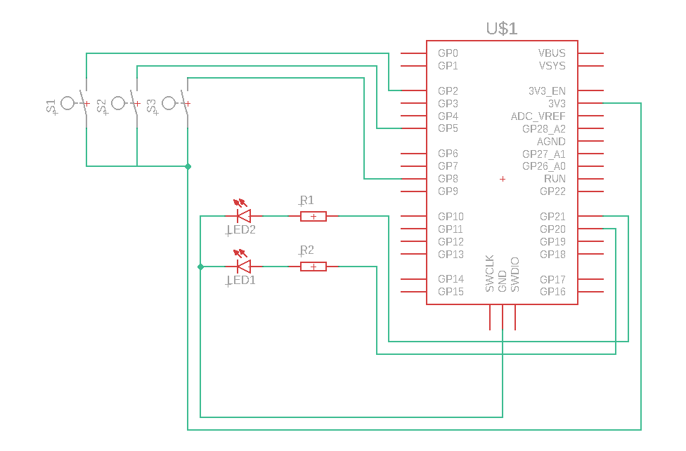
Exercise: Create a binary lock

Slide 14
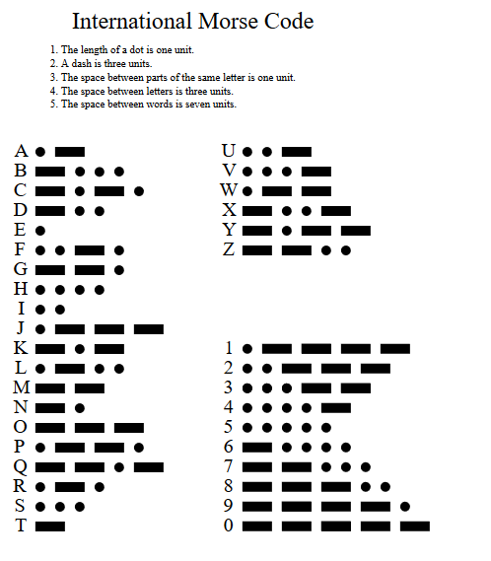
Exercise: Create a Morse code decoder
Morse code is a way to translate between written alphabets and ‘.’s and ‘-’s
Can be used with 3 of the 5 senses
Sight, hearing, and touch!
Notes:
Didn’t know where to add this but Source: "International Morse code Recommendation ITU-R M.1677-1". itu.int. International Telecommunication Union. October 2009. Archived from the original on 6 November 2012. Retrieved 23 December 2011.

